Slide 1
.
Patient - ventilator asynchronies
Dyspnea, agitation
Muscle lesion, VILI
Hyperinflation, auto-PEEP
Work of breathing, VO₂
Poor sleep quality
.
Sedation
NMB
Muscle strength
Circuit problems/ filters
Pain
Leaks
Mechanical
changes
Patient
Asynchronies
Ventilator
and accessories
Fever / Sepsis
Malfunction
pH
Respiratory
drive
Modes and settings
MV duration
Survival
Notes:
Figure 1: Patient-ventilator asynchrony, determining factors, clinical and physiological effects and associated outcomes. VILI: ventilator-induced lung injury, VO₂: volume of oxygen consumed by the tissues, NMB: neuromuscular blockade, MV: mechanical ventilation.

Slide 2
Potential risk of lung damage
Patient Ventilator Asynchronies
High
Moderate
Phase asynchronies
Flow asynchronies
Low
Trigger
Cycling
Flow
Reverse triggering
Double triggering
Ineffective effort
Auto
triggering
Late
cycling
Premature
cycling
Excessive
flow
Insufficient flow
Notes:
Figure 2: Classification of patient-ventilator asynchronies.
Highlight in red, yellow and green for asynchronies with high, medium and low risk, respectively, of clinical harm to the patient.
Adapted from Daminiani et al, 2020; Holanda et al, 2018.

Slide 3
Ineffective effort
Notes:
Figure 3. Volume, flow and pressure x time curves, showing a simulation of ineffective effort asynchrony. Patient with airflow obstruction and difficulty triggering due to the presence of auto-PEEP, even with a “physiological” muscular effort, but unable. The dots indicate the moment of an ineffective effort.
Paw: airway pressure; Pmus: muscle pressure.

Slide 4
Autotriggering
variations of intrathoracic pressure by the heartbeat
Trigger function
Pressure | Flow
*
*
*
Pmus (cmH2O)
Notes:
Figure 4. Volume, flow and pressure x time curves, illustrating autotriggering asynchrony. In the simulated situation, there is interference of the heartbeats (HR: 80bpm) during volume-controlled ventilation, with a programmed respiratory rate (RR) of 15 rpm. There are flow and pressure oscillations at regular time intervals according to the HR. The increase in total RR was due to triggers induced by the transmission of heartbeats to the flow wave when the trigger function was switched from pressure to flow.
Paw: airway pressure; Pmus: muscle pressure. * autotriggering.

Slide 5
Autotriggering due to air leaks
Leak
Notes:
Figure 5 – Volume and flow x time curves, illustrating autotriggering due to air leaks. Autotriggering in PSV mode due to leakage (arrows). Trigger function set in 2l/min of flow. The arrows indicate cycles with autotriggering, therefore starting without any relation to the patient’s effort. Observe the tidal volume curve that does not return to the baseline due to the air leak, which, when corrected, resolves the asynchrony in the last breathing cycles.

Slide 6
Double triggering
Notes:
Figure 6. Volume, flow and pressure x time curves, respectively, illustrating double triggering. In the simulated situation, the double triggering occurs as a result of the patient's neural time being longer than the ventilator's mechanical time. Note that the first cycle is always triggered by the patient, in this case volume controlled ventilation (VCV) mode.
Paw: airway pressure; Pmus: muscle pressure.

Slide 7
Reverse triggering
Notes:
Figure 7. Volume, flow and pressure x time curves, respectively, illustrating reverse triggering. The reverse triggering corresponds to a respiratory muscle effort triggered by reflex mechanisms resulting from the insufflation of a ventilator-controlled cycle, in this case, in volume-controlled ventilation (VCV) mode. Note the tidal volume stacking (breath stacking) and the elevation of airway pressures during these asynchronies. The dots indicate the moment of a reverse triggering.
Paw: airway pressure; Pmus: muscle pressure.

Slide 8
Premature cycling
Notes:
Figure 8: Volume, flow and pressure x time curves, respectively, illustrating premature cycling asynchrony. The situation above illustrates a patient with restrictive lung disease and cycling asynchrony, which occurs early in relation to the end of the patient's muscular effort. The dots indicate the timing of cycling in a breath during pressure support ventilation (PSV) mode.
Paw: airway pressure; Pmus: muscle pressure.

Slide 9
Late cycling
Notes:
Figure 9: Volume, flow and pressure x time curves, respectively, illustrating late cycling asynchrony. A patient with COPD is in pressure support ventilation (PSV) mode. Breath cycling occurs late in relation to the end of the patient's muscular effort. The dots indicate the point of delayed timing of cycling.
Paw: airway pressure; Pmus: muscle pressure.

Slide 10
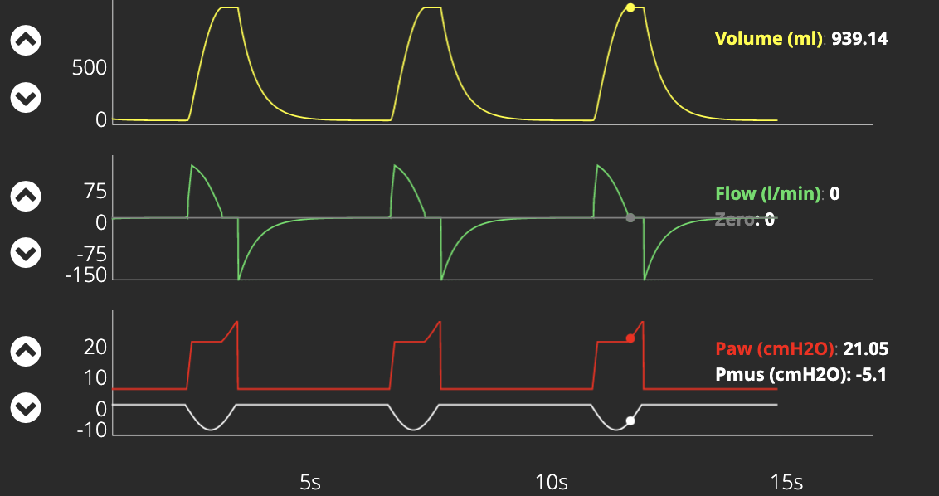
Late cycling with pressure overshoot
Notes:
Figure 10: Volume, flow and pressure x time curves, respectively, illustrating late cycling asynchrony. A patient is in pressure-controlled ventilation (PCV) mode. Pressure overshoot occurs at end expiration with elevation of airway pressure during muscle relaxation. Airway pressure rises by the effect of a high inspired tidal volume in relation to the respiratory system compliance.
Paw: airway pressure; Pmus: muscle pressure.

Slide 11
Insufficient flow
Notes:
Figure 11: Volume, flow and pressure x time curves, respectively, illustrating insufficient flow asynchrony. A patient simulated in volume-controlled ventilation (VCV) mode where the flow is fixed, that is, the flow offer is adjusted by the operator. This situation is commonly called “air hunger”. The dots show the maximal drop in the airway pressure curve in the instant of the maximal negative muscle effort.
Paw: airway pressure; Pmus: muscle pressure.

Slide 12
Excessive flow
Notes:
Figure 12: Pressure and flow x time curves, respectively, illustrating excessive flow type asynchrony. A patient is in pressure-controlled ventilation (PCV) mode Excessive initial flow is associated with an early pressure overshoot (white arrow) at the beginning of the respiratory cycle.

Slide 13
Trigger asynchronies
Mechanisms, risks and possible solutions
Variants | Reverse triggering | Double triggering | Ineffective effort | Autotriggering
Mechanisms | Diaphragm activation due to reflex mechanisms induced by a mechanically controlled cycle | Patient's neural respiratory time > ventilator mechanical time | Decreased Pmus / respiratory drive Decreased sensitivity Auto-PEEP | Leaks Heartbeat transmissions Secretions/condensate into the circuit
Risks | Breath stacking VILI | Breath stacking VILI | Muscle injury Dyspnea Respiratory drive increase | Hyperventilation Auto-PEEP
Possible solutions | Reduce sedation or NMB infusion depending on the clinical context | Increase of the ventilator inspiratory time | Reduce/remove sedation Increase sensitivity Increase/titrate PEEP | Circuit cleaning Appropriate trigger setting
Notes:
Table 1: Main mechanisms, risks and possible solutions of trigger asynchronies.

Slide 14
Cycling and flow asynchronies
Mechanisms, risks and possible solutions
 | Cycling |  | Flow
Variants | Premature cycling | Late cycling | Insufficient flow | Excessive flow
Mechanisms | Mechanical ventilator inspiratory time < patient neural inspiratory time | Mechanical ventilator inspiratory time > patient neural inspiratory time | Flow rate < patient ventilatory demand | Flow rate > patient ventilatory demand
Risks | Respiratory discomfort Dyspnea | Respiratory discomfort Dyspnea Hyperinflation | Dyspnea Increased respiratory drive and work of breathing | Airway pressure overshoot
Possible solutions | Increase ventilator inspiratory time | Decrease ventilator inspiratory time | Flow increase (VCV) Use PCV or PSV modes | Reduce flow or increase rise time in PCV or PSV modes
Notes:
Table 2: Main mechanisms, risks and possible solutions of cycling and flow asynchronies. PCV: Pressure-controlled ventilation PSV: Pressure-support ventilation

Slide 15
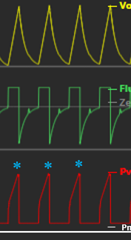
Trigger asynchronies
Ineffective effort
Autotriggering
Double triggering
Reverse triggering
Notes:
Figure 13: Volume, flow and pressure x time curves displayed on the mechanical ventilator screen. Yellow : volume (ml); green: flow (l/min); red: pressure (cmH2O), gray: muscle pressure (cmH2O).*autotriggering.

Slide 16
Cycling asynchrony Flow asynchrony
Premature cycling
Late cycling
Insufficient flow
Excessive flow
Notes:
Figure 14: Volume, flow and pressure x time curves displayed on the mechanical ventilator screen. Yellow : volume (ml); green: flow (l/min); red: pressure (cmH2O), gray: muscle pressure (cmH2O). Excessive flow curves are both yellow, in the top, pressure and in the bottom, flow x time.

Slide 17
Recommendations for evaluating patient x ventilator asynchronies through ventilator curves analysis at the bedside
Adjust the scale of the curves (flow, volume and pressure)
Check curves with the screen frozen
Imagine the effect and shape of the Pmus (usually it is the opposite of the flow curve variation)
Determine if the problem is related to:
The patient
- check physical exam, temperature, drive, fever, sedation, NMB, muscle strength
Ventilator
- Modes, settings, equipment characteristics, circuit and accessories.
Notes:
Table 3: Recommendations for assessing patient-ventilator asynchrony at the bedside.

