Slide 1

Indications for capnography in intubated patients receiving mechanical ventilation
Continuous monitoring of pulmonary ventilation
  Early detection of hypoventilation and hyperventilation, essential in neurological patients and elevated intracranial pressure
  Adjustment of tidal volume, respiratory rate, and minute ventilation
Confirmation and continuous monitoring of endotracheal tube position
  Detection of esophageal intubation, displacement, and accidental extubation
Identification of mechanical and obstructive alterations
  Capnogram morphology analysis: “shark fin,” auto-PEEP, asynchronies
Assessment of CPR quality and identification of return of spontaneous circulation
Estimation of physiological dead space, V/Q alterations, and PEEP titration
  P(a–et)CO₂ gradient and ETCO₂ trend analysis
Detection of ventilator malfunction and endotracheal tube issues
  Circuit disconnection, tube obstruction, secretion accumulation
Notes:
Figure 1. Indications and benefits of capnography integrated with mechanical ventilation waveforms in the intubated patient.

Slide 2
Capnography in intubated patients receiving mechanical ventilation
Capnograph
_{mainstream}
Normal capnogram – phases
INSP.
A
B
I Dead space
Mechanical
Ventilator
II Alveolar emptying
PECO₂
B
C
EXP.
C
D
III Alveolar plateau
D
E
IV Inspiration
₄₀ ₋
PaCO₂
₃₇ ₋
P(a-et)CO₂
III
ETCO₂
D
CO₂
_{mmHg}
C
Patient
V _{Ventilation}
₂₅ ₋
PACO₂
II
IV
.
VCO₂
_{Metabolism}
PvCO₂
PaCO₂
Q _{Perfusion}
I
₀
A
B
E
Expiration
_{Time (s)}
Notes:
Figure 2. Diagram illustrating mainstream capnography applied to the artificial airway of an intubated patient. Exhaled CO₂ partial pressure (PetCO₂) results from the interaction between CO₂ production, determined by cellular metabolism, pulmonary perfusion (the hemodynamic component), and alveolar ventilation (the ventilatory component). Continuous measurement of PetCO₂ throughout expiration yields a time-based capnogram composed of four phases. Phase I corresponds to exhalation of dead space volume, reflecting the dead space to tidal volume ratio (VD/VT), during which PetCO₂ equals zero. Phase II represents the transition as alveolar gas begins to empty, characterized by a rapid rise in PetCO₂. Phase III corresponds to the alveolar plateau at end-expiration, where the ETCO₂ (or PetCO₂) value is obtained. The gradient between arterial and end-tidal CO₂ partial pressures, P(a–et)CO₂, typically ranges from 2 to 5 mmHg and becomes smaller as ventilation–perfusion (V/Q) matching approaches ideal homogeneity.

Slide 3
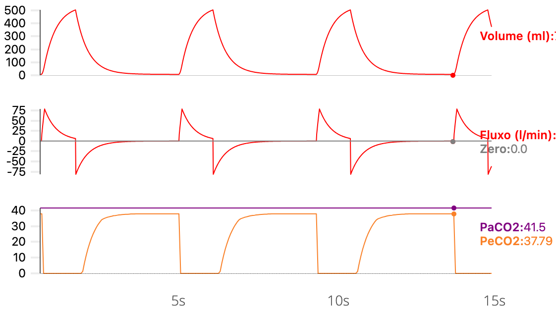

Capnography in intubated patients receiving mechanical ventilation
Normal capnogram integrated with mechanical ventilation waveforms
Capnograph
_{mainstream}
A
B
I Dead space
INSP.
II Alveolar emptying
B
C
Mechanical
Ventilator
C
D
III Alveolar plateau
PECO₂
D
E
IV Inspiration
EXP.
A
B
C
D
E
VD
VT
I
II
III
IV
Notes:
Figure 3. Capnogram waveforms integrated with volume-time and flow-time curves of an ICU mechanical ventilator, demonstrating the four capnographic phases. Phase I corresponds to the exhalation of the dead space volume (VD), with PetCO₂ equal to zero and the potential quantification of VD from the tidal volume (VT) curve. Phase II reflects the transition as alveolar gas is exhaled, with a rapid increase in PetCO₂. Phase III represents the alveolar plateau extending to end-expiration, when expiratory flow returns to zero, and PetCO₂ is measured immediately before Phase IV, the onset of inspiration. ETCO₂ (PetCO₂) is shown with a normal physiological gradient of approximately 2–5 mmHg relative to PaCO₂, presented here for didactic purposes. Waveforms and data generated using the Xlung simulator.

Slide 4
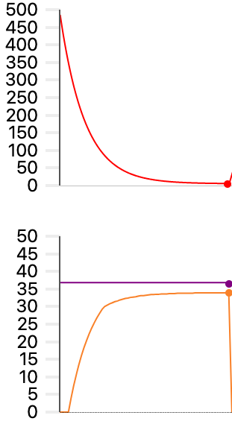
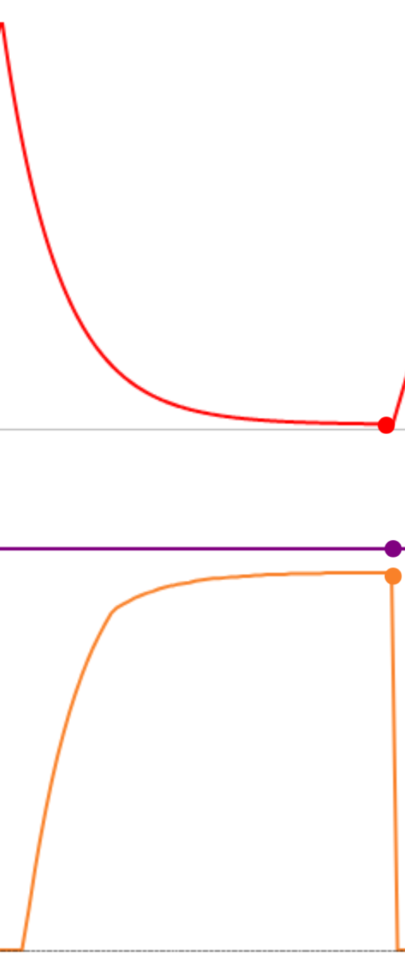
Capnography in intubated patients receiving mechanical ventilation ↑ metabolism and CO₂ production
Capnograph
_{mainstream}
P(a-et)CO₂
Normal
Temperature
INSP.
🌡️ 36ºC
🌡️ 40ºC
Mechanical
Ventilator
↑PaCO₂
↑PECO₂
↑PeCO₂
EXP.
Volume
mL
.
VCO₂
Fever
Sepsis
49
46
37
34
CO₂
mmHg
Patient
Notes:
Figure 4. Capnography in intubated patients receiving mechanical ventilation under conditions of increased metabolism and CO₂ production.
Fever, sepsis, and other hypermetabolic states increase CO₂ production (V̇CO₂), resulting in higher mixed expired CO₂ values (PECO₂). When ventilation–perfusion matching is preserved, both PaCO₂ and ETCO₂ rise proportionally, maintaining a normal arterial-to-end-tidal CO₂ gradient [P(a–et)CO₂]. An increase in body temperature (36 °C vs. 40 °C) alters capnographic values. It elevates CO₂ levels without changes in the expiratory flow pattern, indicating that alveolar hypoventilation, the primary differential diagnosis, is not responsible for the observed changes. Waveforms and data generated using the Xlung simulator.

Slide 5
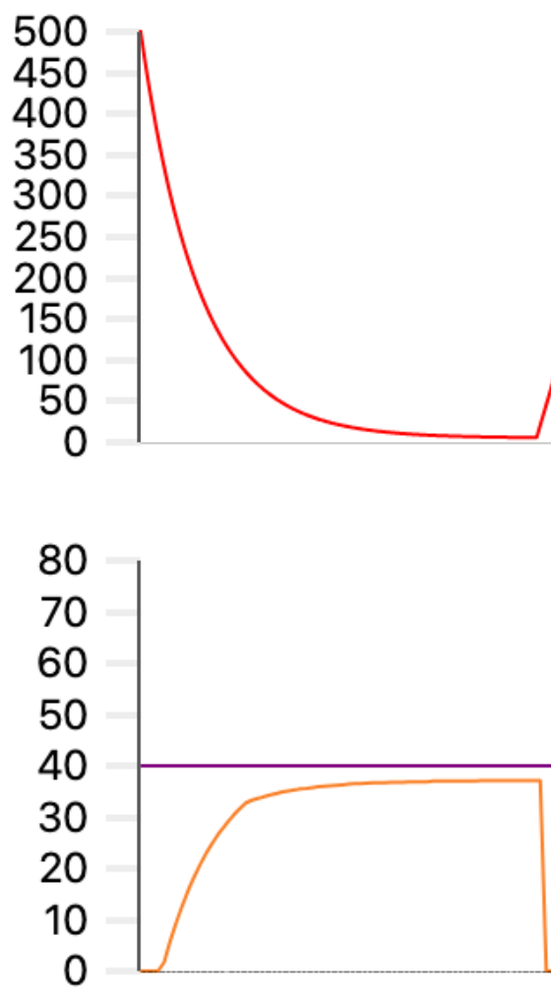
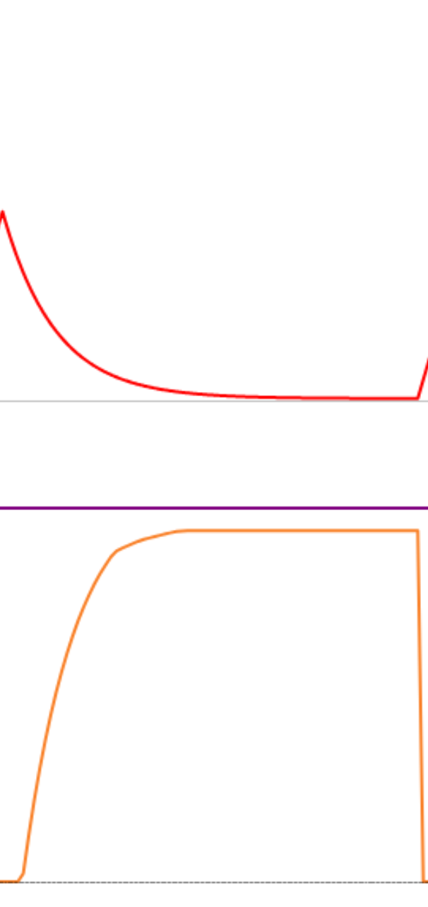
Capnography in intubated patients receiving mechanical ventilation Alveolar hypoventilation due to reduced tidal volume
Capnograph
_{mainstream}
Tidal Volume
P(a-et)CO₂
Normal
INSP.
500ml
250ml
Mechanical
Ventilator
↑PaCO₂
↑PECO₂
↑PeCO₂
EXP.
Volume
mL
V _{Ventilation}
80
↑ PACO₂
75
CO₂
mmHg
40
37
Patient
Notes:
Figure 5. Capnography in intubated patients receiving mechanical ventilation during alveolar hypoventilation secondary to tidal volume reduction. A decrease in tidal volume reduces alveolar ventilation and results in CO₂ retention, producing proportional increases in PaCO₂ and exhaled CO₂ partial pressure (PetCO₂). In the presence of preserved ventilation–perfusion matching, the P(a–et)CO₂ gradient remains within the physiological range. Integration of physiologically normal-shaped capnograms with volume-time curves demonstrating a reduction in exhaled tidal volume from 500 mL to 250 mL supports hypoventilation as the mechanism responsible for increased PaCO₂ and ETCO₂. Waveforms and data generated using the Xlung simulator.

Slide 6
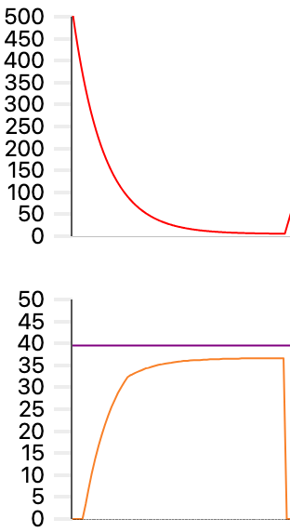
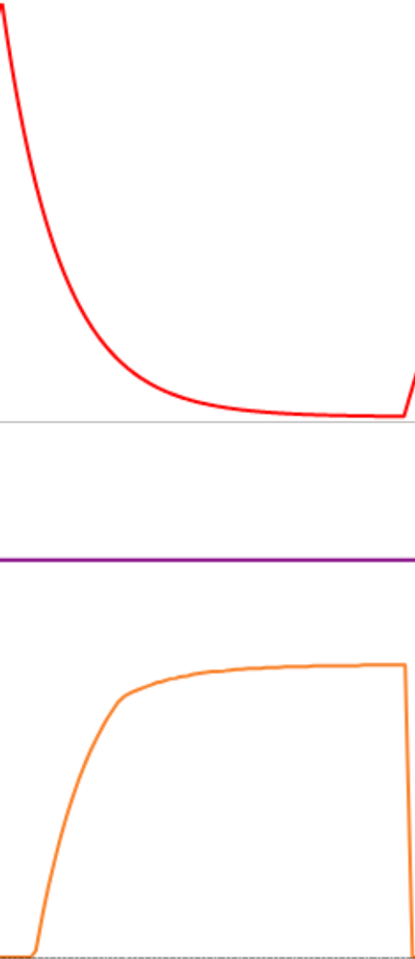
Capnography in intubated patients receiving mechanical ventilation
Pulmonary hypoperfusion due to hemodynamic shock (↓ Cardiac Output)
Capnograph
_{mainstream}
Cardiac output
P(a-et)CO₂
Elevated
INSP.
6L/min
2L/min
Mechanical
Ventilator
↑PaCO₂
↓PECO₂
↓PeCO₂
EXP.
Volume
mL
V _{Ventilation}
↓ PACO₂
48
39
↑VD/VT
37
35
x
CO₂
mmHg
Q _{Perfusion}
↑PaCO₂
Patient
Notes:
Figure 6. Capnography in intubated patients receiving mechanical ventilation during pulmonary hypoperfusion secondary to hemodynamic shock with reduced cardiac output.
A decrease in cardiac output results in impaired pulmonary perfusion and reduced CO₂ delivery to the alveoli, leading to lower exhaled CO₂ (ETCO₂) despite preserved or elevated arterial CO₂ (PaCO₂). This condition is associated with increased physiological dead space (VD/VT) and widening of the P(a–et)CO₂ gradient. Capnograms obtained under conditions of normal (6 L/min) and reduced (2 L/min) cardiac output demonstrate a marked reduction in ETCO₂ with unchanged mechanical ventilation, highlighting the predominantly hemodynamic contribution to the observed capnographic alterations. Waveforms and data generated using the Xlung simulator.

Slide 7
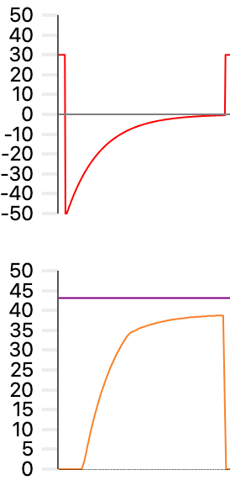
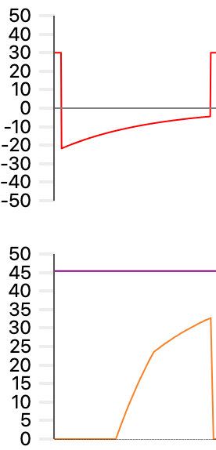

Capnography in intubated patients receiving mechanical ventilation
Airflow limitation with increased airway resistance and auto-PEEP
Capnograph
_{mainstream}
Rva cmH₂O.L.s
P(a-et)CO₂
Elevated
INSP.
9
27
Mechanical
Ventilator
↑PaCO₂
↓PECO₂
↓PeCO₂
EXP.
↑Rva
Flow
L/min
Auto-PEEP
Airflow limitation
V _{Ventilation}
Auto-PEEP
↑ VD/VT
43
45
↑ PACO₂
38
33
CO₂
mmHg
Q _{Perfusion}
↑PaCO₂
Patient
VD/VT
Notes:
Figure 7. Capnography in an intubated patient receiving mechanical ventilation with airflow limitation, increased airway resistance, and the development of auto-PEEP.
Increased airway resistance (Raw) promotes expiratory flow limitation, impairing complete lung emptying. This condition results in dynamic air trapping and the generation of auto-PEEP, evidenced by the inability of expiratory flow to return to zero before the onset of the next inspiratory cycle. Consequently, effective alveolar ventilation is reduced, leading to an increase in the dead space-to-tidal volume ratio (VD/VT). Capnography typically demonstrates reduced ETCO₂ values despite a concomitant rise in PaCO₂, reflecting alveolar hypoventilation associated with widening of the P(a–et)CO₂ gradient. The capnogram exhibits a progressive upward slope of Phase III, characteristic of the classic shark-fin pattern seen in airflow obstruction. At the same time, the flow-time waveform confirms the presence of auto-PEEP. Waveforms and data generated using the Xlung simulator.

Slide 8
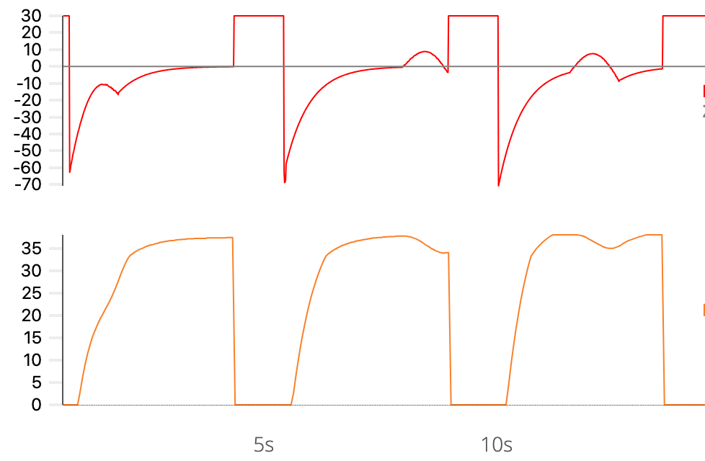
Capnography in intubated patients receiving mechanical ventilation
Recovering respiratory muscle effort after NMB
Capnograph
_{mainstream}
EtCO₂
P(a-et)CO₂
Variables
INSP.
Mechanical
Ventilator
PECO₂
*Ineffective efforts
EXP.
*
*
*
Flow
L/min
Curare “clefts"
37
38
34
CO₂
mmHg
Notes:
Figure 8. Diagram illustrating ineffective inspiratory efforts, visible on the flow waveform, and their corresponding effects on the capnogram. In this example, waveforms were generated by simulating reduced inspiratory muscle effort, as may occur during partial recovery from neuromuscular blockade (curare cleft). These events may occur near end-expiration, producing transient entrainment of CO₂-free gas, thereby altering PetCO₂ and potentially affecting ETCO₂ measurements. Consequently, variations in the P(a–et)CO₂ gradient may also be observed. NMB: neuromuscular blockade. Waveforms and data generated using the Xlung simulator.

Slide 9
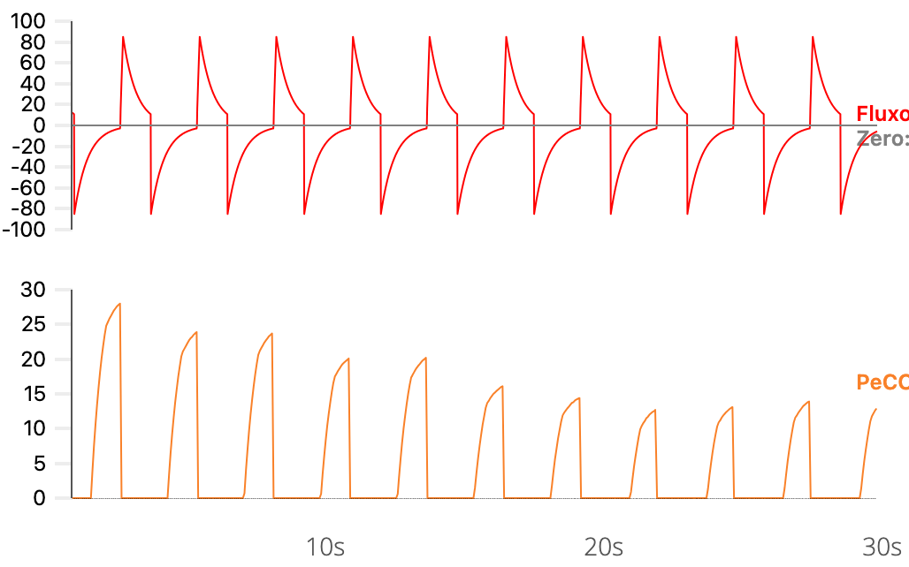
Capnography in intubated patients receiving mechanical ventilation
Progression to cardiac arrest
Capnograph
_{mainstream}
EtCO₂
Rapid decline to zero
INSP.
Mechanical
Ventilator
PECO₂
EXP.
Flow
L/min
CPR→
38
CO₂
mmHg
Notes:
Figure 9. Capnography in an intubated patient receiving mechanical ventilation during progression to cardiorespiratory arrest (CRA). As severe and rapidly progressive hemodynamic deterioration occurs, with abrupt reduction in cardiac output, pulmonary perfusion collapses, leading to a marked reduction in CO₂ delivery to the alveoli. Consequently, ETCO₂ rapidly declines toward near-zero values despite preservation of the ventilatory pattern, as evidenced by the maintained flow-time waveform.

Slide 10

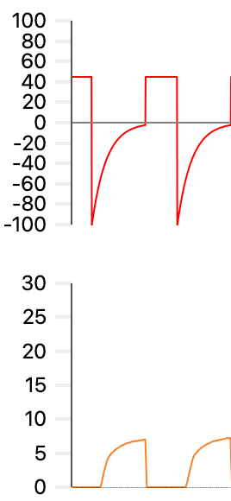
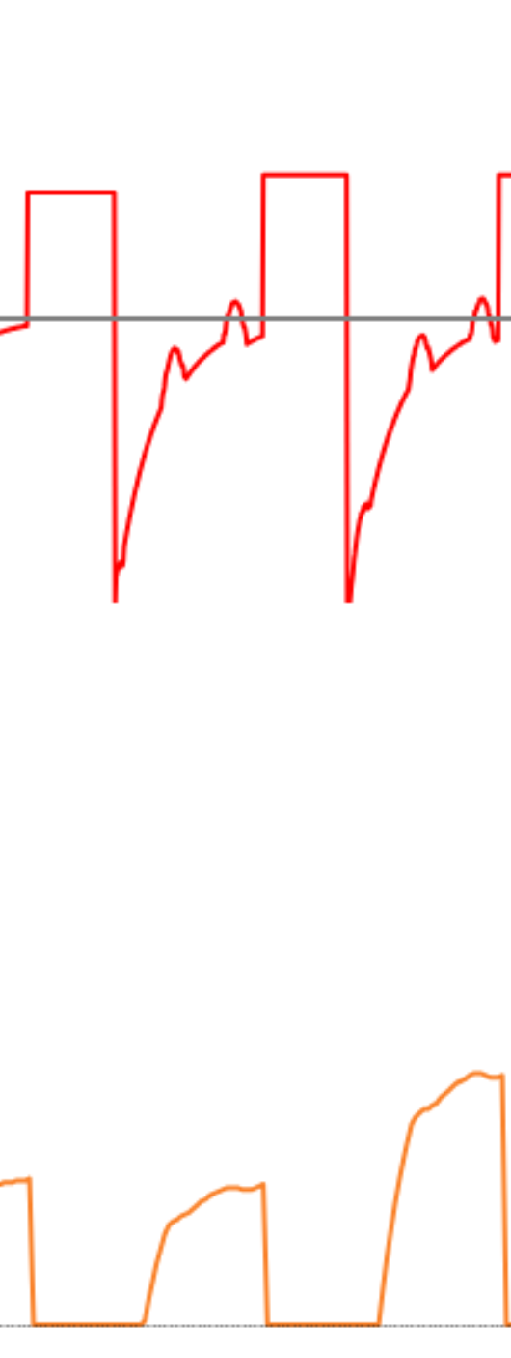
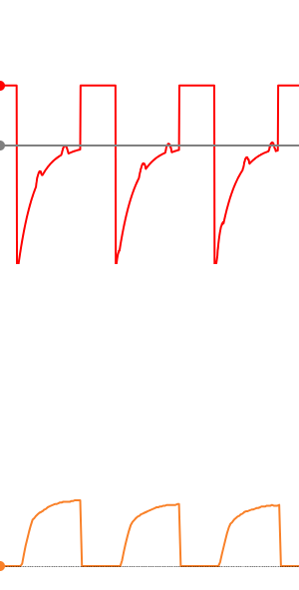
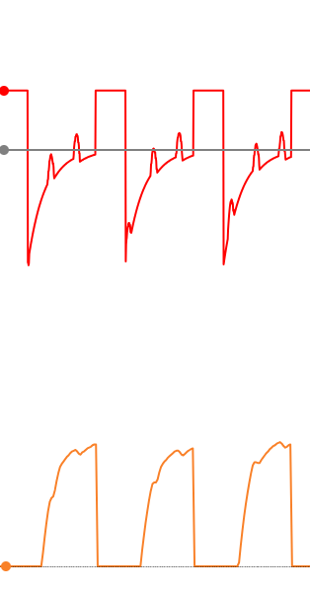
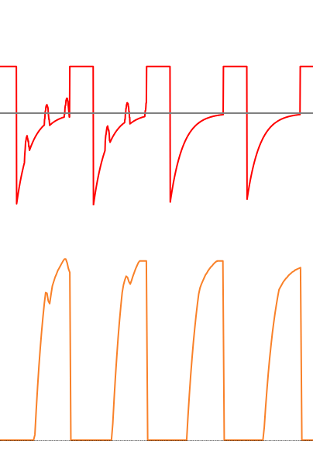
Capnography in intubated patients receiving mechanical ventilation
Cardiopulmonary resuscitation until ROSC after cardiac arrest
EtCO₂
- Reflects the quality of chest compressions
- Identifies the return of spontaneous circulation
Ok
Weak
Strong
Flow
L/min
Initiation of CPR
ROSC
CO₂
mmHg
EtCO₂
Target range
Notes:
Figure 10. Capnography in an intubated patient receiving mechanical ventilation during cardiopulmonary resuscitation, from cardiopulmonary resuscitation (CPR) through initiation of chest compressions to return of spontaneous circulation (ROSC). During CPR, ETCO₂ values directly reflect pulmonary blood flow generated by chest compressions and serve as an indirect marker of compression quality. Ineffective compressions are associated with low ETCO₂ values, whereas more effective compressions produce progressive increases in ETCO₂ within the target range. A sustained and abrupt rise in ETCO₂ represents the classic indicator of ROSC. Flow-time waveforms demonstrate maintenance of ventilatory pattern throughout resuscitation, with oscillations related to chest compressions. At the same time, the capnogram shows the transition from low exhaled CO₂ levels during CPR to higher, more stable values after ROSC. Waveforms and data generated using the Xlung simulator.

Slide 11
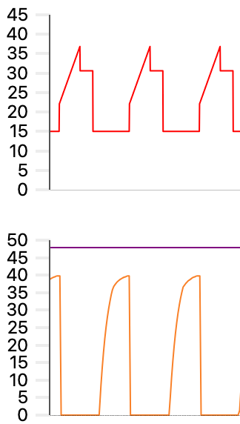
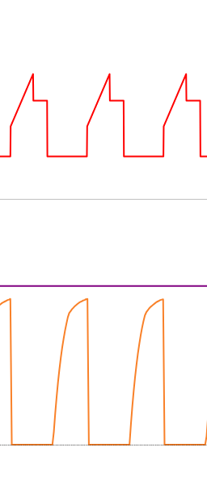
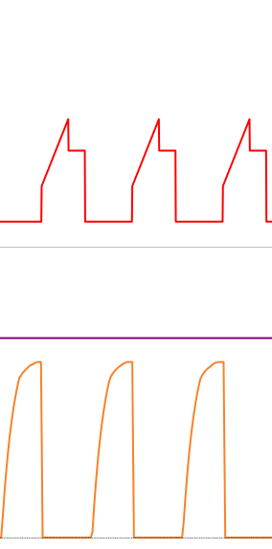
Capnography in intubated patients receiving mechanical ventilation
Effect of PEEP on respiratory mechanics and P(a–et)CO₂ in ARDS
Driving
Pressure
_{cmH2O}
Alveolar overdistension
↑VD/VT
and/or ↓ perfusion
15,5cmH₂O
12cmH₂O
14cmH₂O
↑
P(a-et)CO₂
Airway
Pressure _{cmH2O}
↑
Alveolar Recruitment
↓ VD/VT
and/or ↑ perfusion
PEEP: 15cmH₂O
PEEP: 10cmH₂O
PEEP: 5cmH₂O
48
44
PaCO₂
40
42
38
39
PeCO₂
CO₂
_{mmHg}
Notes:
Figure 11. Capnography in an intubated patient with Acute Respiratory Distress Syndrome (ARDS) receiving mechanical ventilation in volume-controlled ventilation (VCV) mode with tidal volume set at 6 mL/kg predicted body weight during decremental PEEP titration (15 → 10 → 5 cmH₂O). A PEEP level of 10 cmH₂O resulted in the lowest driving pressure and the smallest P(a–et)CO₂ gradient, findings consistent with reduced pulmonary overdistension and greater alveolar aeration and/or improved ventilation–perfusion (V/Q) matching compared with the other tested PEEP levels. Waveforms and data generated using the Xlung simulator.

Slide 12

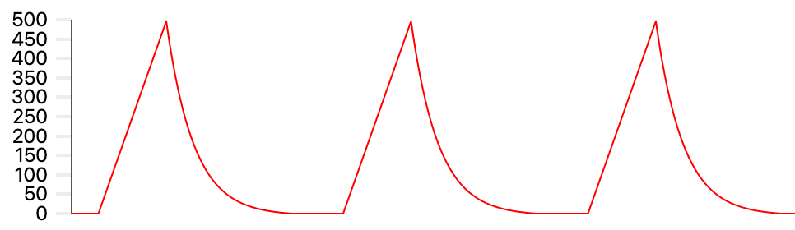
Capnography in intubated patients receiving mechanical ventilation
Findings Associated with Ventilatory Support Problems
A) Rebreathing Due to Expiratory Valve Malfunction
PiCO₂ > 0
CO₂
mmHg
B) Air Leak
Volume
Leak
CO₂
mmHg
Time
Notes:
Figure 12. Capnography in intubated patients receiving mechanical ventilation with abnormalities in the control of inspiratory and expiratory gas flow within the ventilator circuit.
In A) CO₂ rebreathing caused by expiratory valve malfunction results in partial return of exhaled gas at the onset of inspiration (Phases IV and I of the capnogram). An increase in inspired CO₂ partial pressure is observed (PiCO₂ > 0), proportional to the severity of rebreathing. In the absence of compensatory hyperventilation, PetCO₂ may also increase. In B) the presence of a circuit leak causes early reduction in PetCO₂, preventing the formation of the alveolar plateau and generating a characteristic capnogram morphology.

Slide 13
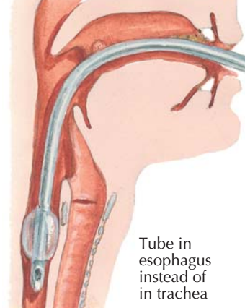
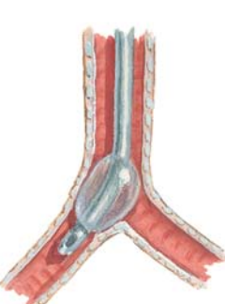
Capnography in intubated patients receiving mechanical ventilation
Findings Associated with Endotracheal Tube Problems
A) Esophageal Intubation
CO₂
mmHg
B) Endobronchial Intubation
Endotracheal Tube Repositioned
in the Trachea
CO₂
mmHg
Notes:
Figure 13. Capnography in intubated patients receiving mechanical ventilation.
In A) esophageal intubation is characterized by extremely low or absent PetCO₂ values, sometimes displaying small transient waveforms due to residual CO₂ within the upper gastrointestinal tract immediately after intubation, followed by a flat tracing. The expression “no trace, wrong place” has been proposed to emphasize the urgency of immediate corrective action. In B) migration of the distal end of the endotracheal tube into the right main bronchus produces asymmetric lung emptying, resulting in a biphasic capnogram morphology. This pattern is typically corrected following appropriate repositioning of the tube within the trachea.

Slide 14
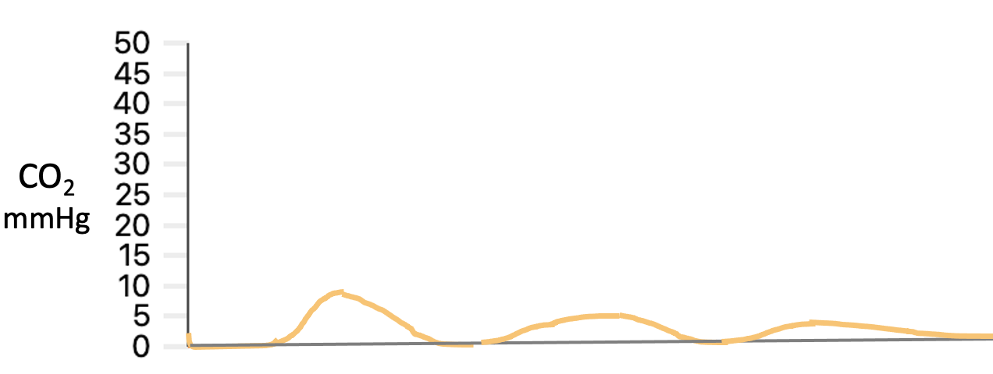
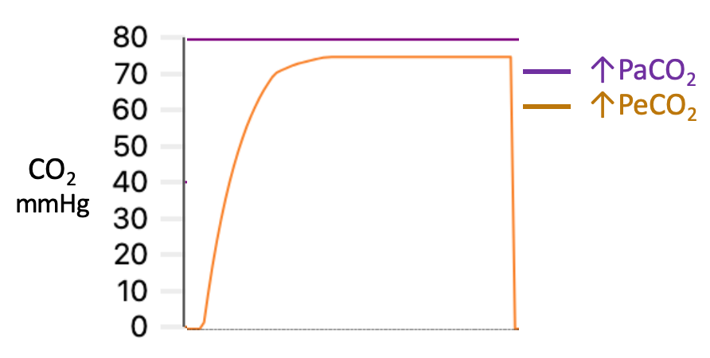
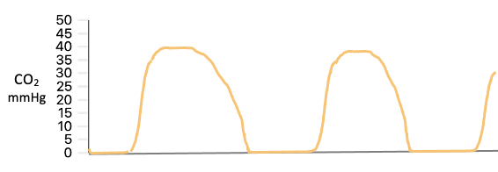
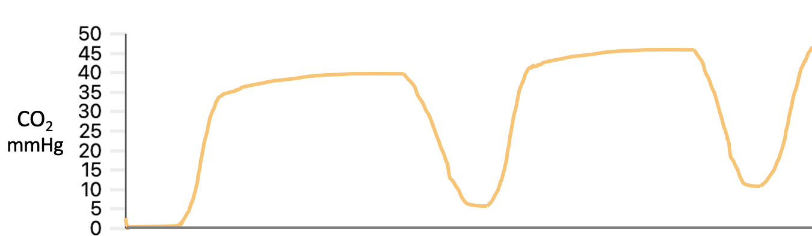
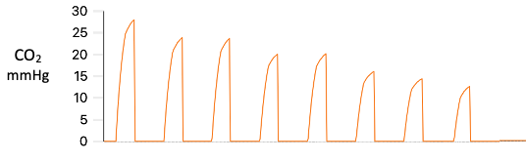
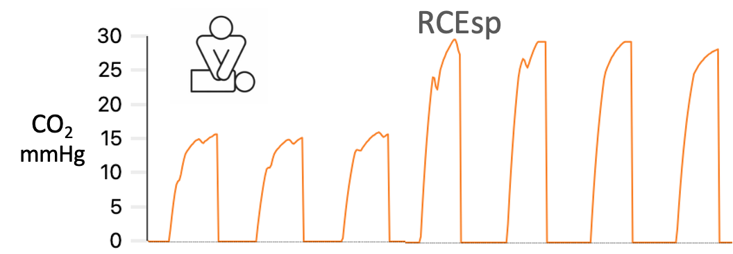
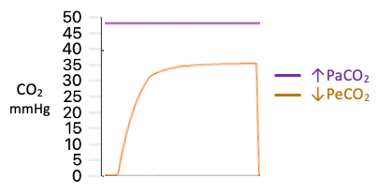
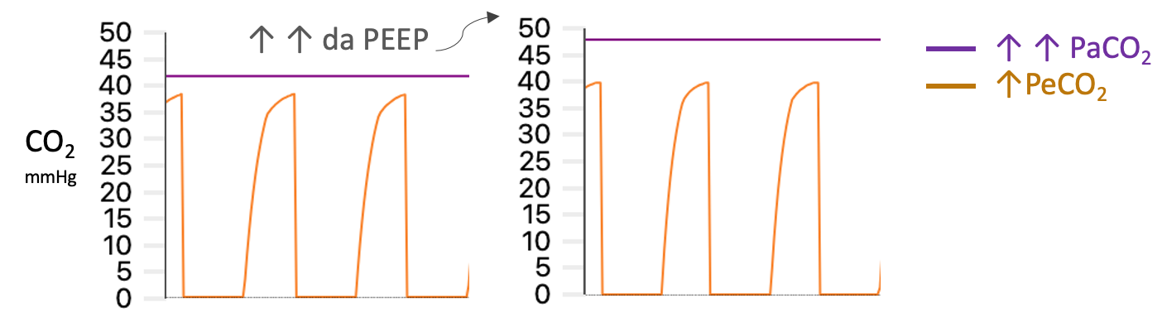
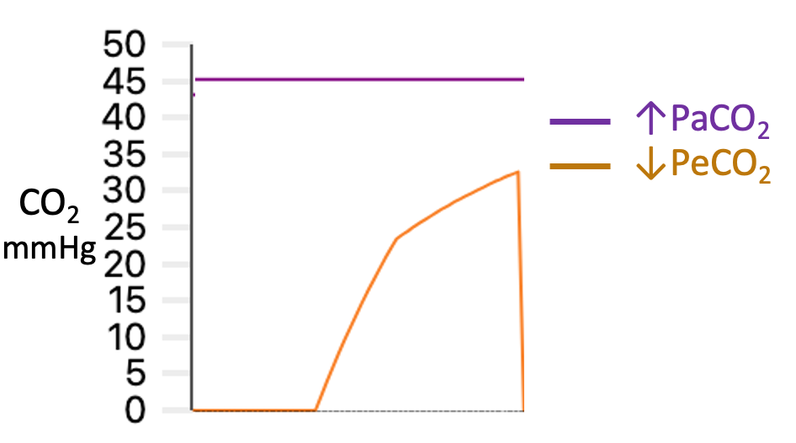
Capnographic Findings in Intubated Patients Receiving Mechanical Ventilation
↓EtCO₂
↑EtCO₂
Esophageal intubation or circuit disconnection
↑Metabolic rate and/or hypoventilation
Air leak
CO₂ rebreathing
Cardiorespiratory arrest
Return of spontaneous circulation (ROSC) during CRA
Shock or pulmonary embolism
Alveolar overdistension
↑ Excessively high PEEP
Airflow obstruction
www.xlung.net
Notes:
Figure 14. Summary of the main clinical conditions and their corresponding capnographic findings discussed in this chapter.

